Slide 1
Progress belongs to those who understand the future of money.
Progressive Sistas MAGIC is built by sistas, for sistas, uniting education, financial literacy, and Web3 innovation to ensure Black women are informed, prepared, and empowered in the evolving digital economy.

Slide 2
Meet the Team Behind Progressive Sistas Magic
Our leadership team combines diverse expertise with a shared passion for empowering Black women in the evolving digital economy. Each member brings a unique perspective and invaluable skills, creating a powerhouse of knowledge, community, and innovation.
Our Vision
Our Mission
To be the leading platform for Black women seeking financial empowerment and Web3 literacy.
To educate, inspire, and connect Black women to thrive in the digital financial landscape.

Slide 3
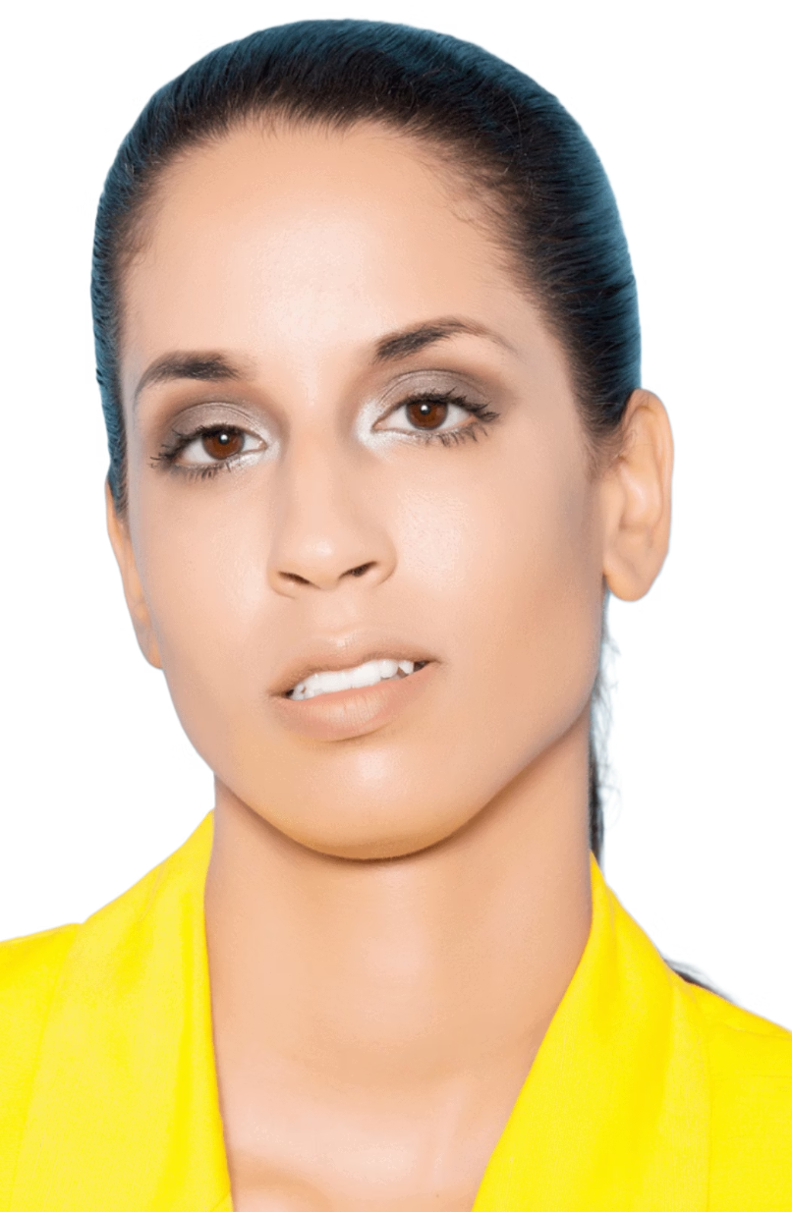
Andre’a Garrison: The Visionary Founder
Founder | Healthcare & Financial Literacy Advocate
Andre’a Garrison is a healthcare and finance professional with over seven years of experience in the medical industry, complemented by a strong foundation in financial services and education. A graduate of Cincinnati State in Medical Assisting and Administrative Duties, her career has been defined by precision, service, and a commitment to helping others succeed.
In 2025, Andre’a earned her national certifications in Medical Billing and Coding through the American Academy of Professional Coders (AAPC) and is currently founding her own medical billing company, supporting healthcare providers in streamlining operations and maximizing reimbursements. Her earlier experience working in mutual funds and proxy services sparked a lasting interest in financial literacy and long-term wealth building.

Slide 4
The Genesis of Progressive Sistas MAGIC
Andre’a’s journey into cryptocurrency began through early conversations with her older brother, who introduced her to the principles of financial independence and the transformative potential of digital assets. What started as curiosity quickly evolved into a disciplined exploration of the crypto ecosystem, where she immersed herself in understanding how value is created, distributed, and scaled through blockchain technology.
As her knowledge deepened, Andre’a built a strong foundation in decentralized systems and the broader digital asset landscape. She closely observed how major industries including finance, artificial intelligence, and healthcare were converging with blockchain, reshaping the future of innovation and economic access. Andrea witnessed major U.S. institutions move decisively into crypto from financial leaders like BlackRock, Fidelity and JPMorgan Chase to payment giants Visa, Mastercard, and PayPal, alongside engagement from U.S. regulators including the Treasury, Federal Reserve, SEC, and CFTC, signaling blockchain’s shift from experimental to foundational in global finance.
Throughout this journey, Andre’a identified a critical gap in the space: the absence of a strong, supportive voice encouraging women especially “sistas” to confidently enter and thrive in crypto. Recognizing the need for representation, accessible education, and guided mentorship, she took action.
This vision led to the creation of a purpose driven platform built to empower, educate, and elevate women within the blockchain and crypto ecosystem where learning is structured, support is ongoing, and industry experts actively guide the next generation of leaders.
1
2
3
Inspiration
Purpose
Community
Sparked by discussions on financial freedom and digital assets.
To equip women of color with crypto and DeFi knowledge.
Building a supportive network for digital financial success.

Slide 5
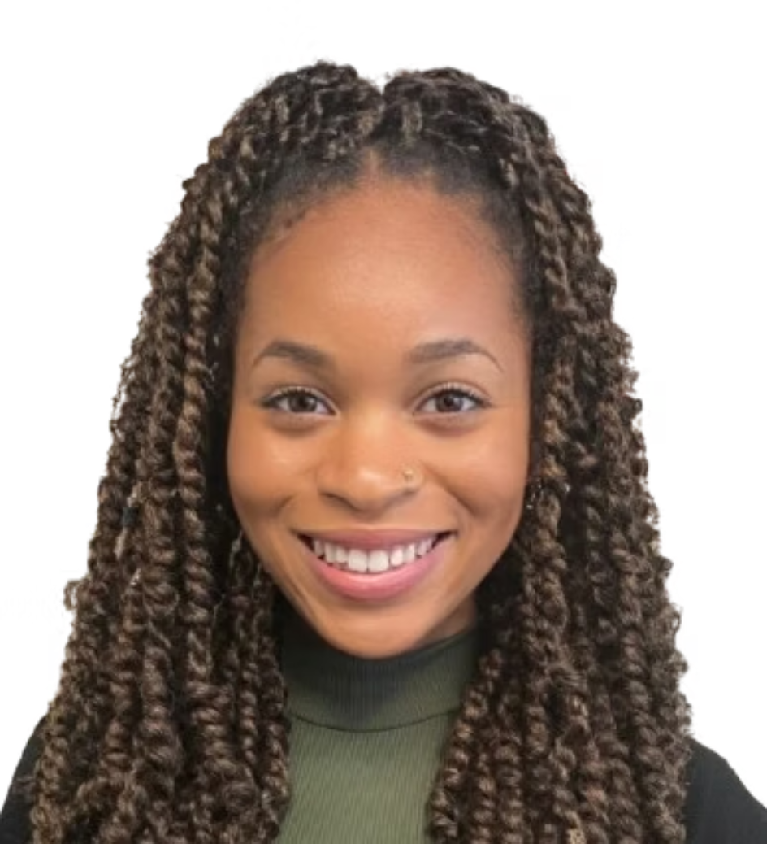
Deyzhah Knox: Crypto & Finance Educator
Crypto & Finance Educator | Global Markets Analyst
Deyzhah Knox is a finance professional, global markets analyst, and digital educator with an academic foundation in international economics and finance. She earned her Bachelor’s degree in Political Science with a specialization in International Diplomacy from Louisiana State University and is currently pursuing a Master’s degree in Finance at the University of Houston, focusing on International Banking and Finance.
She began her career in the commodities sector as a news reporter covering oil and gas markets, gaining firsthand insight into international trade, energy markets, and global economic systems. Deyzhah later transitioned into full time trading, specializing in stock options and cryptocurrency markets.
Academic Excellence
Market Insight
Digital Educator
International Economics and Finance expert.
Experienced in commodities, stock options, and crypto markets.
Creator of "Digitally Deyzhah," empowering financial literacy.

Slide 6





Deyzhah's Impact: Educating for Financial Independence
As the creator of Digitally Deyzhah on YouTube, she educates audiences on financial principles, market strategies, and practical tools for financial independence. Her channel serves as a vital resource for individuals seeking to demystify complex financial concepts and apply them to their own lives.
She is also the founder of Rationalizing Irrationality LLC, a multidisciplinary company exploring global finance, culture, and policy. Deyzhah brings both analytical rigor and educational clarity to Progressive Sistas Magic’s advisory panel, ensuring our community receives top-tier, actionable financial education.
Rationalizing Irrationality LLC
Digitally Deyzhah
YouTube channel for financial education.
Exploring global finance, culture, and policy.
Educational Clarity
Market Strategies
Demystifying complex financial concepts.
Practical tools for financial independence.

Slide 7
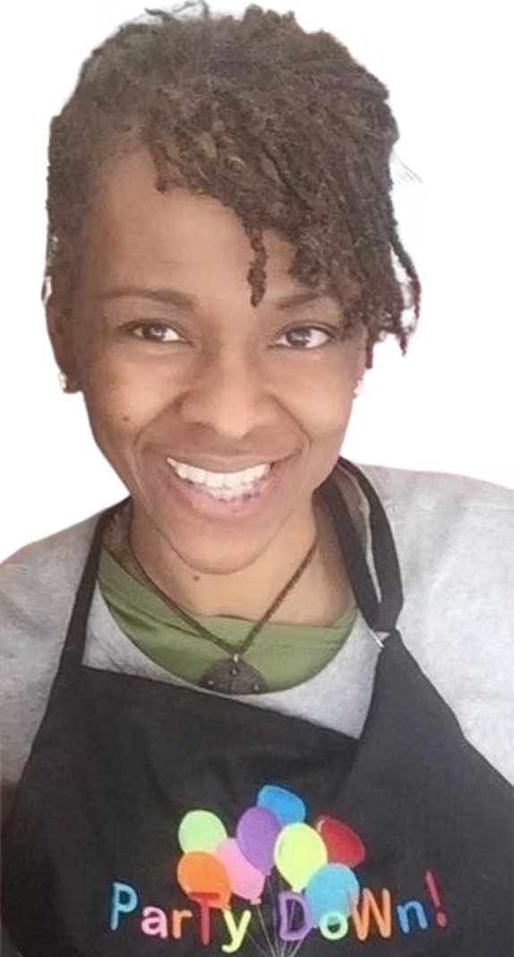
Joyce Warner: Healthcare & Community Support
Healthcare Professional | Community & Advisory Support
Joyce Warner is a seasoned healthcare professional and entrepreneur with more than two decades of experience in patient care and laboratory services. After attending Howard University, she built a long standing career as a mobile phlebotomist and later as a laboratory technician at Chestnut Hill Pediatrics, which became part of Children’s Hospital of Philadelphia (CHOP), where she served for over 15 years.
Following her healthcare career, Joyce co-founded a family-owned party supply business in Pennsylvania, reflecting her dedication to entrepreneurship, community involvement, and generational collaboration.
As she expands her understanding of cryptocurrency and digital finance, Joyce brings real world operational experience, discipline, and a community-first mindset to the Progressive Sistas Magic advisory panel.
20+
15+
Years of Experience
Years at CHOP
Dedicated to patient care and laboratory services.
A long-standing career at a renowned institution.

Slide 8
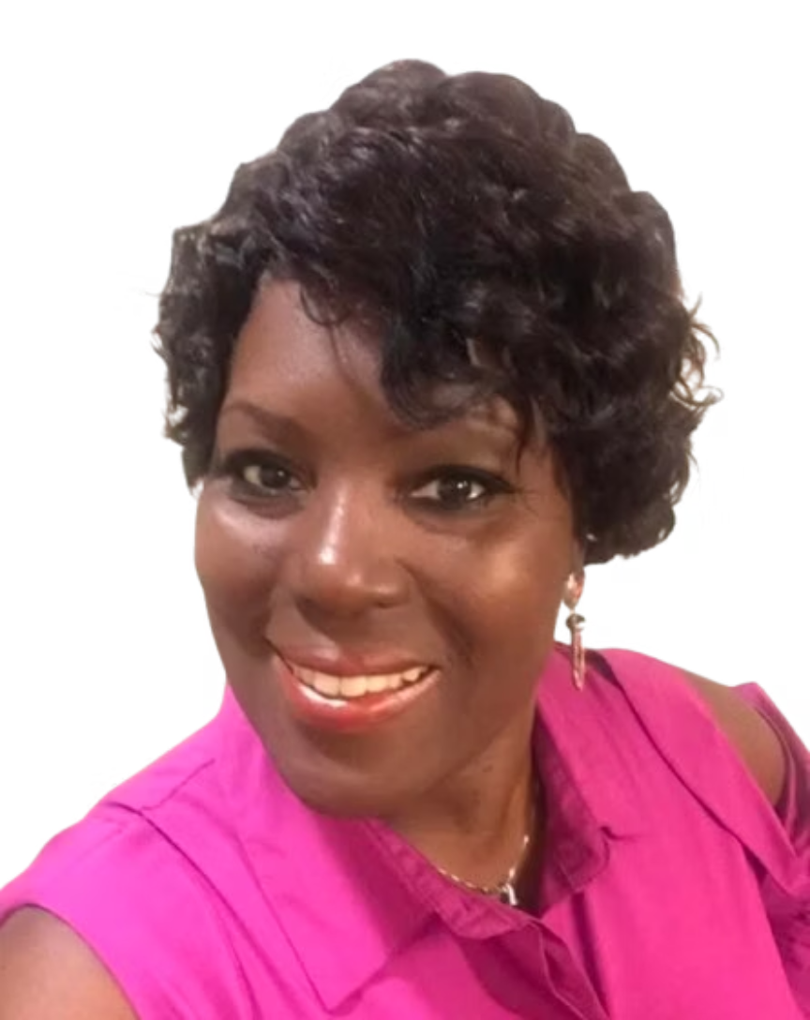



Valerie Crummedyo: Entrepreneurial Insight
Entrepreneur | Business & Financial Literacy Advocate
Valerie Crummedyo is an entrepreneur and business professional with experience across finance, human resources, publishing, and hospitality. She began her academic journey at Shaw University and later earned an Associate’s Degree and certification as a Human Resources Specialist from Houston Community College.
Valerie is the founder of Bramia’s LLC, an umbrella company encompassing Bramia’s Water Ice, Bramia’s Publishing, and Just Cruzin’, a travel planning service. Her ventures reflect a commitment to creativity, operational excellence, and community engagement.
With a growing focus on financial literacy and emerging technologies, Valerie contributes business acumen, adaptability, and entrepreneurial insight to the Progressive Sistas Magic advisory panel.
Business Acumen
Creative Ventures
Adaptability
Expertise across diverse industries.
Bramia's LLC: Water Ice, Publishing, Travel.
Navigating emerging technologies and markets.

Slide 9
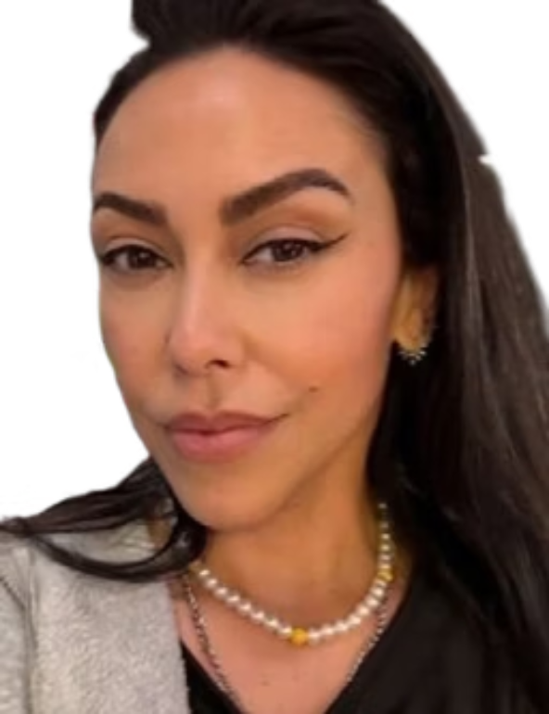
Jacqueline Ramos: Real Estate & Brand Leadership
Real Estate Professional | Brand Leader | Community Builder
Jacqueline Ramos joins the Advisory Panel of Progressive Sistas MAGIC with a dynamic blend of real estate expertise and high-end retail brand leadership. A licensed real estate professional with deep roots in the vibrant Miami residential market, Jacqueline has built her distinguished career on a foundation of relationship-building, strategic marketing, and consistently delivering exceptional results across diverse client bases.
Jacqueline began her career at the Gold Coast School of Real Estate, establishing herself by serving buyers, sellers, commercial developers, and brokerages throughout South Florida. She expanded her impact as a Real Estate Coordinator for the Fortune 100 Group in Miami, contributing to strategic, large-scale projects. Most recently, she served as a Brand Manager at Neiman Marcus in Charlotte, representing global luxury retailers while honing her skills in premium client service and market positioning.
At Progressive Sistas MAGIC, Jacqueline brings a unique and invaluable perspective shaped by her comprehensive background in real estate, luxury branding, and client-centered service. Her extensive experience working with diverse communities and high-net-worth clientele adds significant depth to our mission, enhancing our ability to attract a broader and more diverse crypto learning community. She strengthens our approach to brand engagement, partnership development, and overall community growth.
Real Estate Acumen
Brand Leadership
Community Growth
Expertise in Miami's residential market & strategic marketing.
Representing luxury brands with client-centric service.
Driving diversity and strengthening brand engagement.

Slide 10
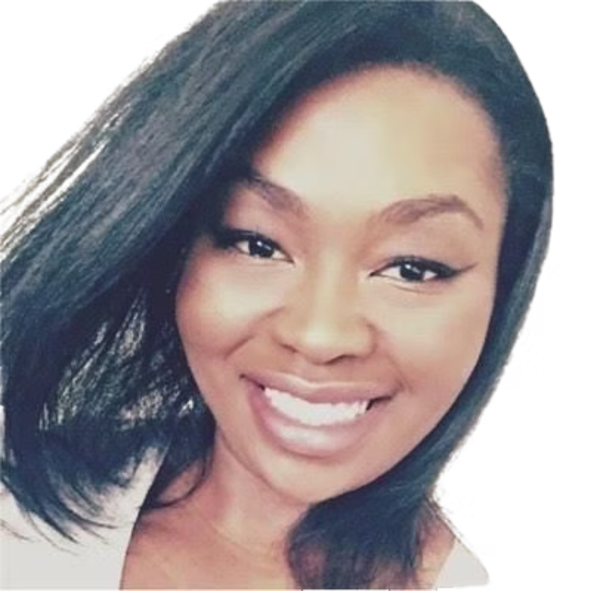
Teila Kelly: Operations & Customer Experience
Customer Service Coordinator | Digital Literacy Advocate
Teila Kelly brings a wealth of experience in operations and customer experience to the Progressive Sistas MAGIC Advisory Panel. With a Bachelor’s in Media and Information from Michigan State University, she understands the critical role of streamlined processes and effective communication in successful ventures.
Currently a Customer Service Coordinator at CBRE, she optimizes large-scale service delivery through proactive scheduling, cross-functional collaboration, and workflow improvements.
Her diverse background, spanning healthcare, technical support, and various corporate sectors, has equipped her with a robust skill set. Teila is proficient in data-informed solutions and platforms such as Salesforce, ServiceNow, and JIRA, which she leverages to drive operational excellence. Beyond her professional achievements, Teila is a passionate advocate for digital literacy and the empowerment of women in technology and financial sectors.
As a member of the Progressive Sistas MAGIC Advisory Panel, Teila contributes invaluable insights into operational strategy and community advocacy, further strengthening our commitment to financial innovation and accessible education for all.
Operational Excellence
Customer Experience
Optimizing service delivery through workflow improvements.
Proactive scheduling and cross-functional collaboration.
Digital Literacy
Data-Informed Solutions
Advocating for empowerment in tech and finance.
Leveraging platforms like Salesforce, ServiceNow, and JIRA.

Slide 11




Built With Purpose: A United Front
Progressive Sistas Magic is guided by experience, education, and intention. Our team brings together healthcare professionals, financial educators, entrepreneurs, and community leaders, united by a shared mission to ensure sistas are not left behind in the digital financial era.
Our collective strengths provide a holistic approach to financial literacy and Web3 education, ensuring that every Sista has the resources, knowledge, and confidence to succeed. We believe that true progress is achieved when we uplift each other, breaking down barriers and building bridges to a more equitable financial future.
Healthcare
Financial Education
Precision and care.
Empowering knowledge.
Community Leadership
Entrepreneurship
Support and connection.
Innovation and growth.

Slide 12


Join the Movement: Your Future is Digital
The future of finance is here, and Progressive Sistas MAGIC is dedicated to ensuring Black women are at the forefront. We invite you to join our growing community, engage with our expert educators, and begin your journey toward financial freedom and Web3 mastery.
Together, we can unlock new opportunities, build lasting wealth, and create a powerful legacy for generations to come. Your journey into the digital economy starts now!

